Slide 1


Slide 2
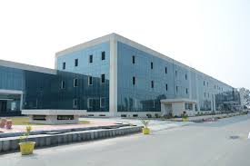
MUSKAN MAHAJAN
B. TECH (CSE)
11700059
DAV UNIVERSITY

Slide 3
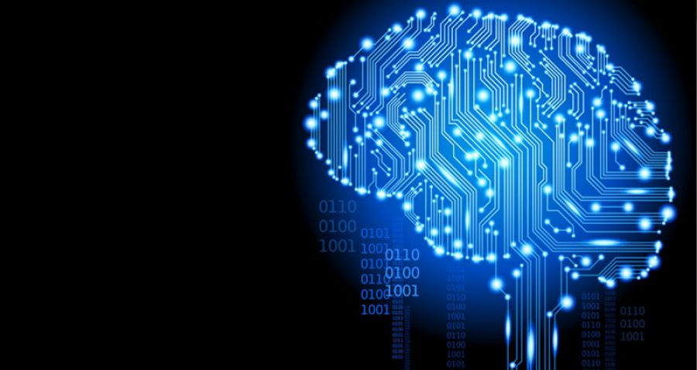
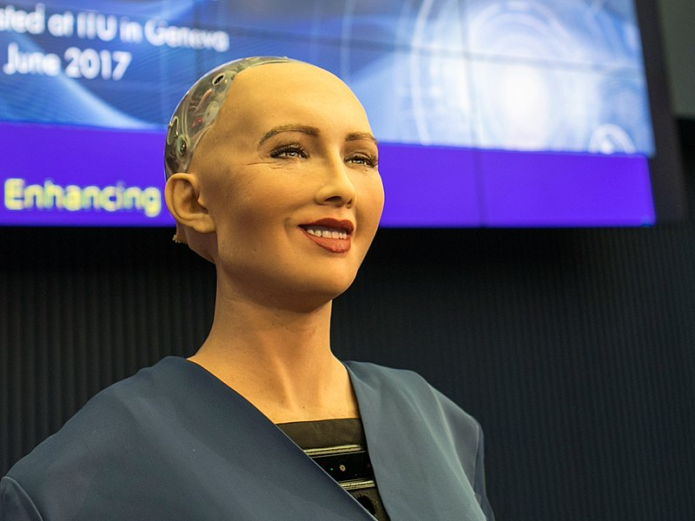
MACHINE
LEARNING

Slide 4
WE USE MACHINE LEARNING DAILY.
BUT WHERE?
LETS SEE…

Slide 5
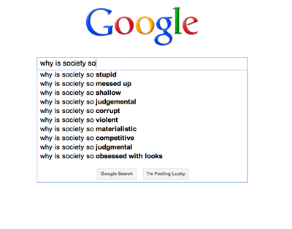

Slide 6
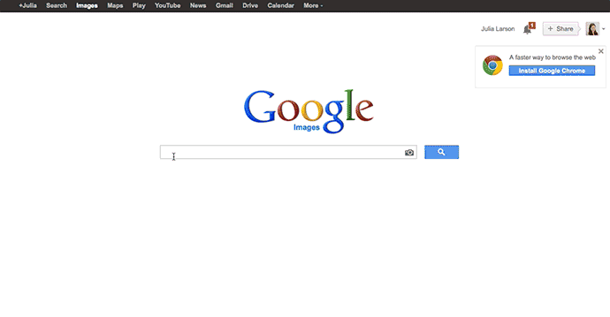

Slide 7
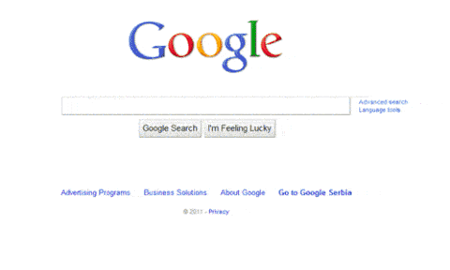

Slide 8
Google
Search

Slide 9
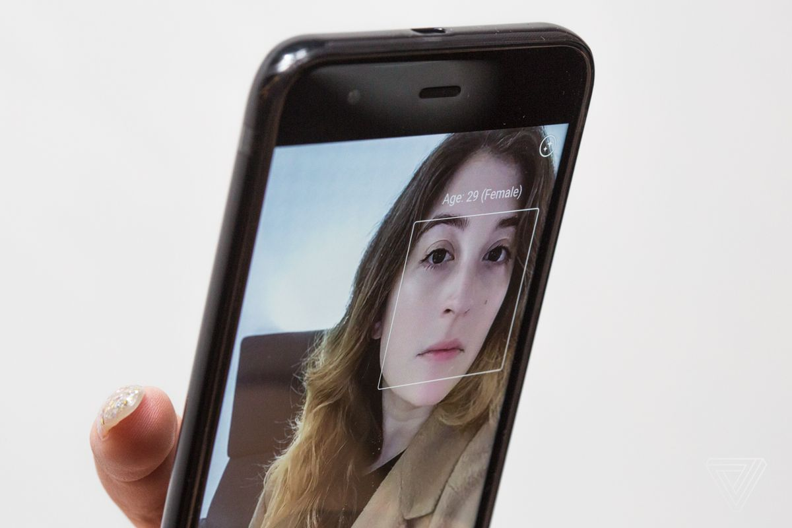

Slide 10
Age Prediction
in camera

Slide 11
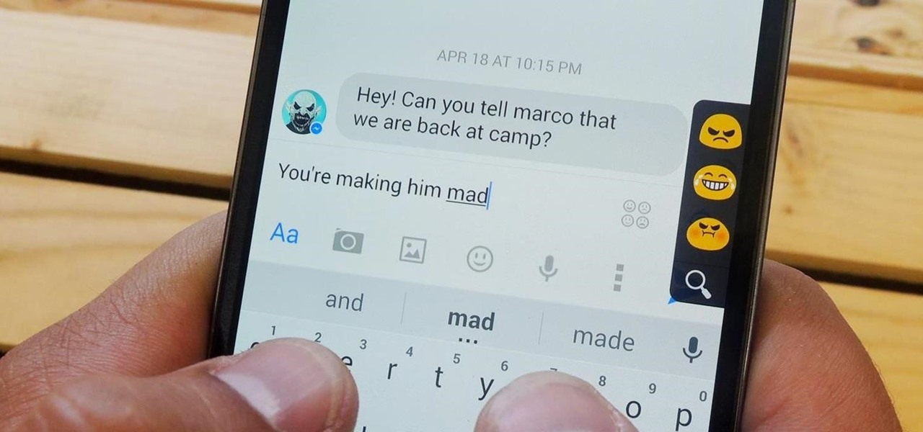

Slide 12
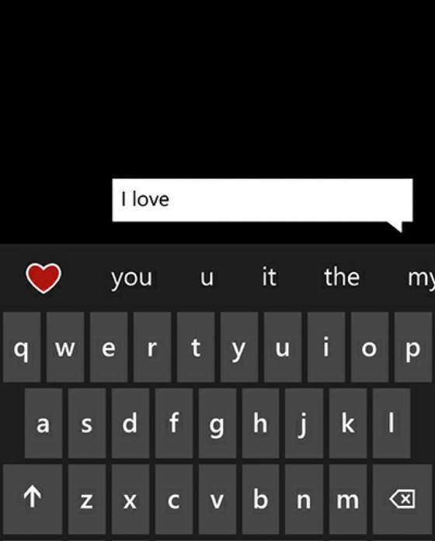

Slide 13
Word Prediction
on Keyboard

Slide 14
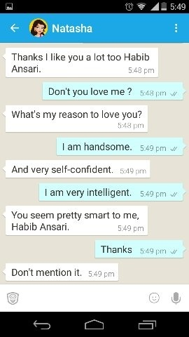
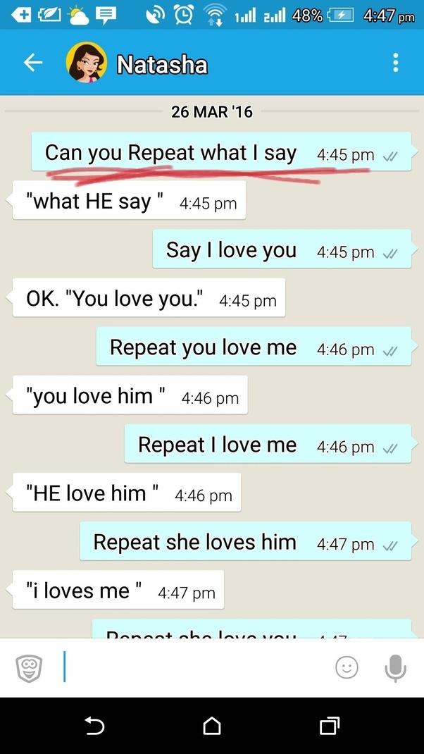

Slide 15
Chat Bot

Slide 16
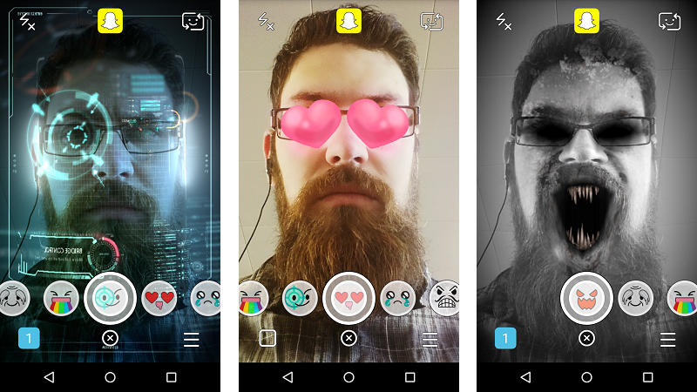

Slide 17


Slide 18
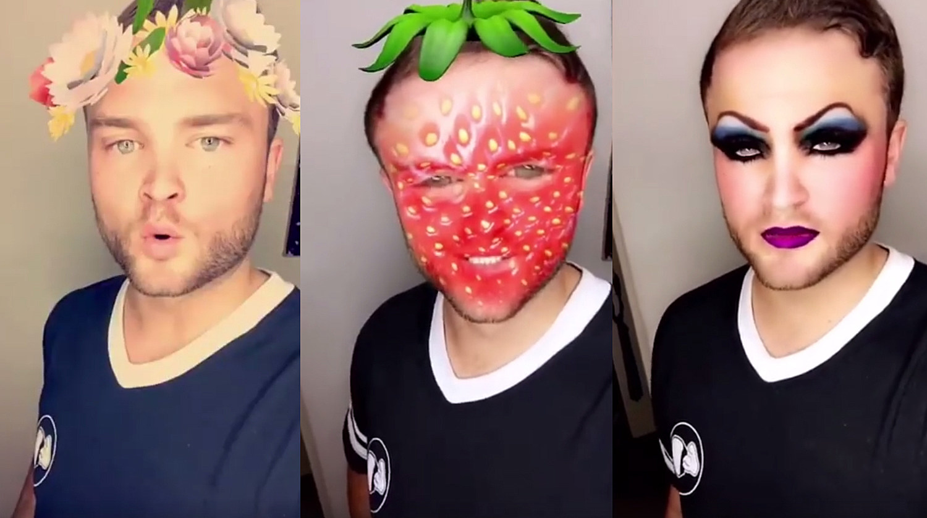

Slide 19
Camera
Filters

Slide 20
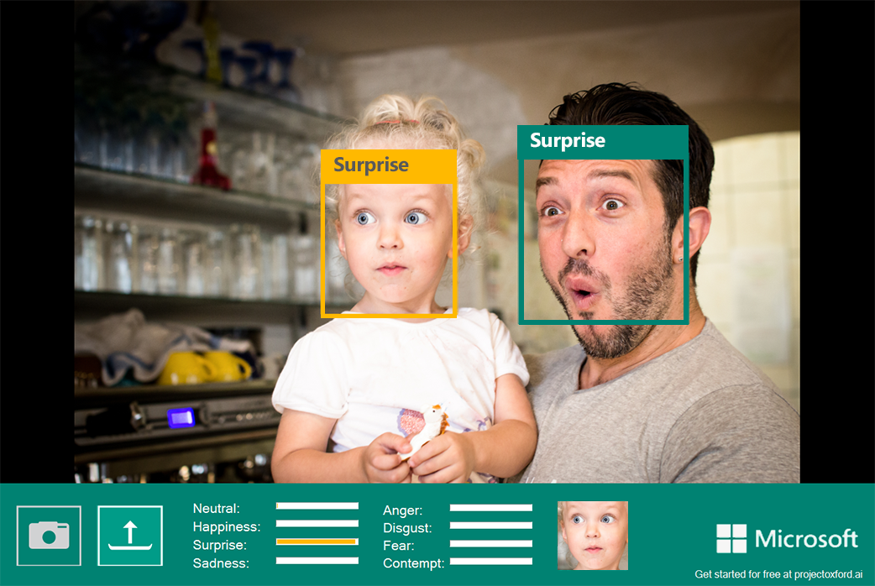

Slide 21
Emotion
Prediction
By Cameras

Slide 22

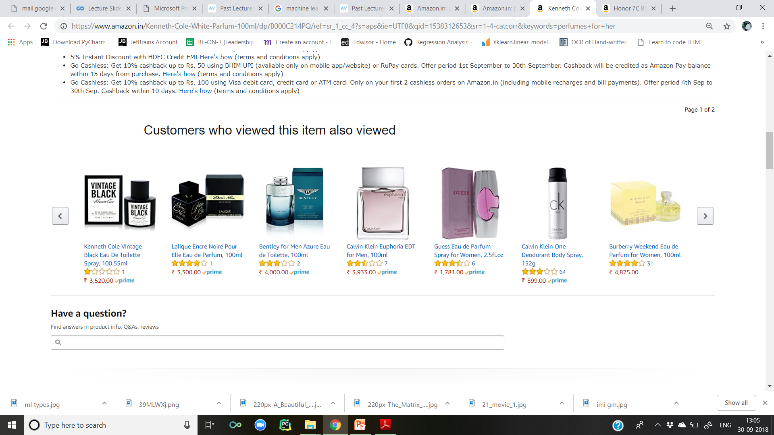

Slide 23
Recommender
Systems

Slide 24
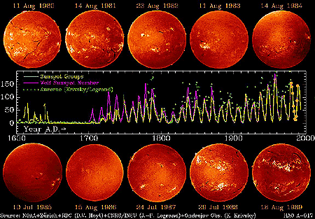
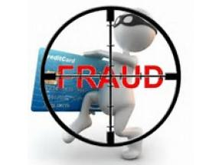
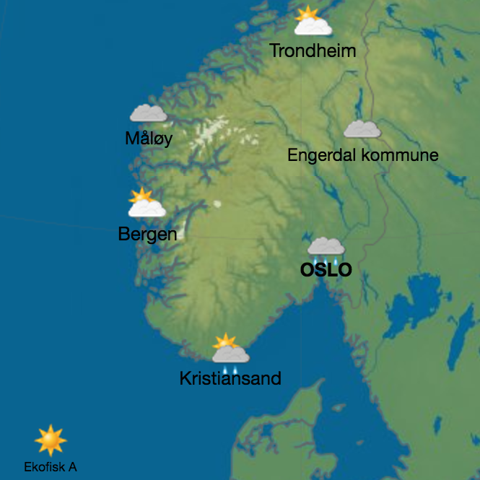
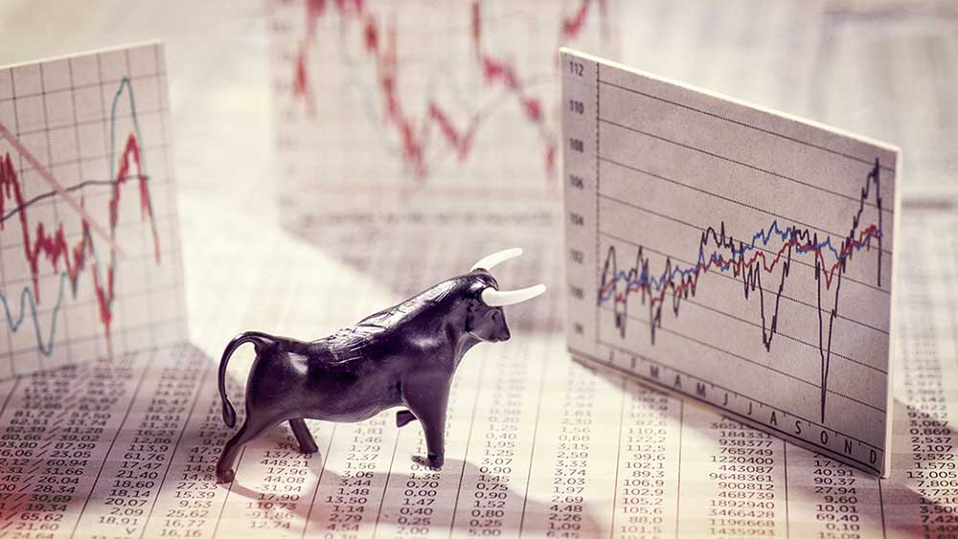

Slide 25
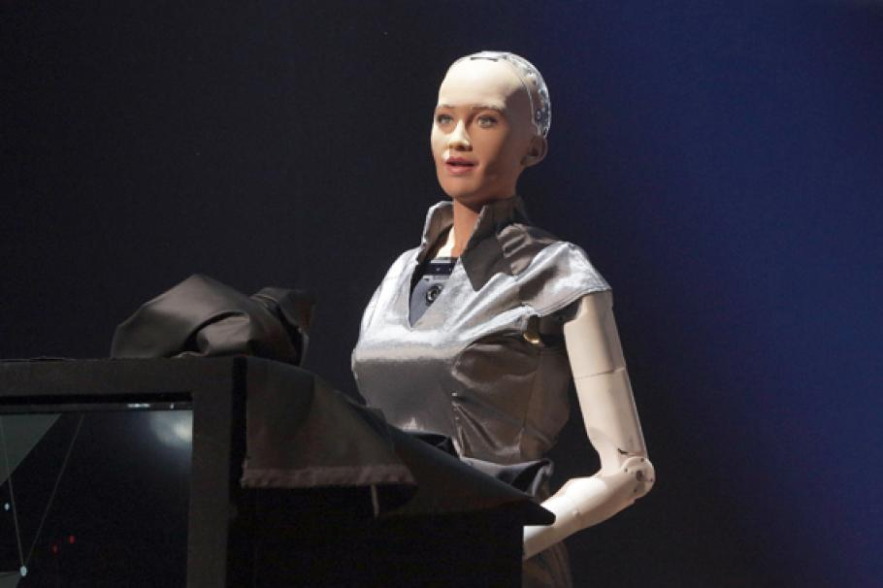

Slide 26
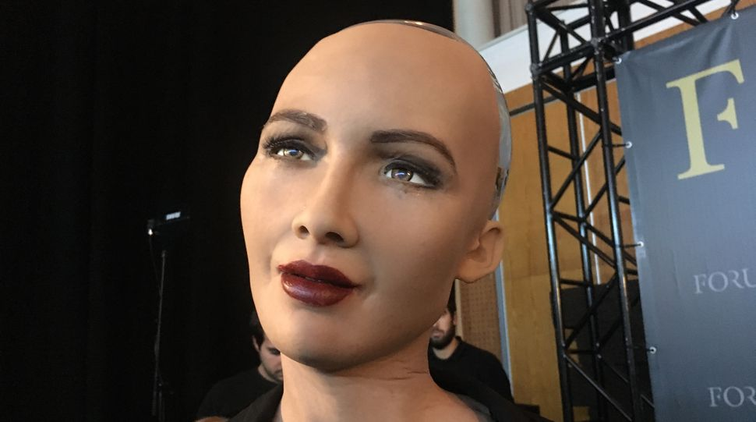

Slide 27
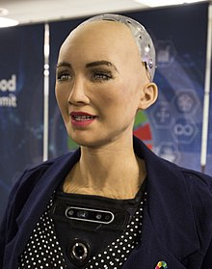

Slide 28
Sophia
Sophia is a social humanoid robot developed by Hong Kong-based company Hanson Robotics. Sophia was activated on April 19, 2015 and made her first public appearance at South by Southwest Festival (SXSW) in mid-March 2016 in Austin, Texas, United States. She is able to display more than 50 facial expressions.

Slide 29
Sophia, the robot became the first robot to receive citizenship of “SAUDI ARABIA”.
Sophia's internals cameras within Sophia's eyes combined with computer MACHINE LEARNING ALGORITHMS allow her to see. She can follow faces, sustain eye contact, and recognize individuals. She is able to process speech and have conversations using a natural language subsystem. Around January 2018 Sophia was upgraded with functional legs and the ability to walk.

Slide 30
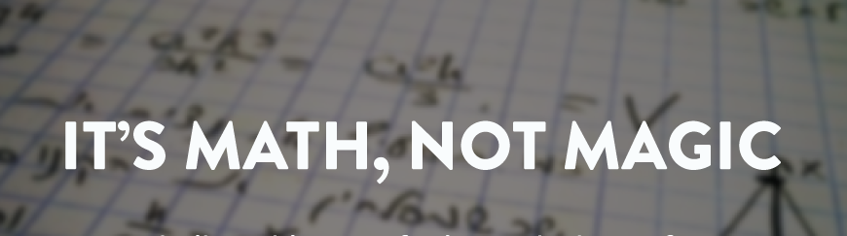
TECHNICAL TERMS

Slide 31
definition
Machine learning is a subfield of artificial intelligence (AI) concerned with algorithms that allow computers to learn. What this means, in most cases, is that an algorithm is given a set of data and infers information about the properties of the data—and that information allows it to make predictions about other data that it might see in the future.

Slide 32
What are the different skills and information do you need to cook something?
Skills to Cook : Programming language, Linear Algebra, Statistics and Probability
Kitchen: Machine Learning Setup (IDE)
Recipe: The Machine Learning Design Cycle
Ingredients: Data
If you know the RECIPE, then with the right SKILLS and INGREDIENTS you can easily cook a Machine Learning model in your KITCHEN and enjoy a great result of it.

Slide 33
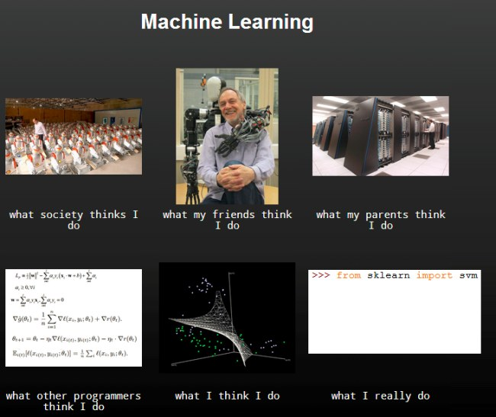

Slide 34
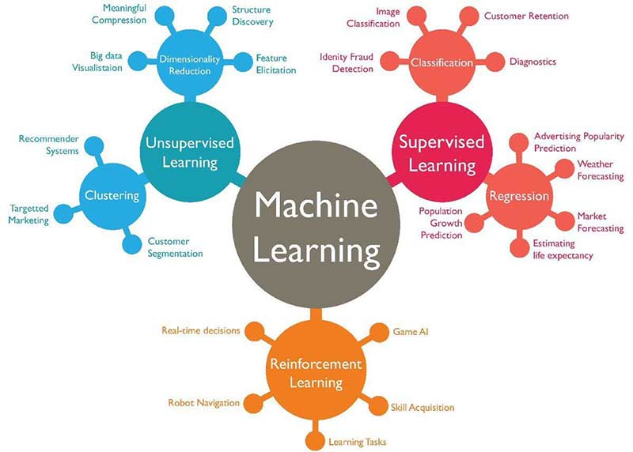
Types of machine learning algorithms

Slide 35
supervised learning
Firstly data is required to train our model and we have to pre process it to clean it and convert it into suitable form.
Then we split the data in two sets, one of these sets is called the Train Set and the other is called the Test Set.
The train set, as the name suggests is used to train our machine learning algorithm.
The test set is then used to test the outcomes of our algorithms.
This works exactly as human brain firstly model is trained and then tested. Like our examination system.

Slide 36
Types of supervised learning
Regression
Used to predict the continuous valued data based on single(linear regression) or multiple attributes(polynomial regression).
For example: Predicting housing price, stocks price, gold price, petrol price
Classification
Used to predict categorical data based on certain attributes.
For example: Predicting if somebody can suffer from heart attack or not, in an accident a person can be alive or not, a customer will buy the product or not.
It is based on conclusion.

Slide 37
Unsupervised learning
Unsupervised learning allows us to approach problems with little or no idea what our results should look like. We can derive structure from data where we don't necessarily know the effect of the variables.
We can derive this structure by clustering the data based on relationships among the variables in the data.
With unsupervised learning there is no feedback based on the prediction results.

Slide 38
Type of unsupervised learning
Clustering
Firstly we select the n number of elements randomly as per the number of clusters we want and we call them centroids.
Then we take each point and compare it with selected centroids.
Again select a new centroid from each cluster randomly and compare all other with them and get improved clusters.
This continues till we get no more change.
Finally we get n number of clusters of similar elements.

Slide 39
Reinforcement learning
Reinforcement Learning machines and software agents to automatically determine the ideal behaviour within a specific context, in order to maximize its performance. Simple reward feedback is required for the agent to learn its behaviour; this is known as the reinforcement signal.
an agent is supposed decide the best action to select based on his current state. When this step is repeated, the problem is known as a Markov Decision Process.
Reinforcement Learning allows the machine or software agent to learn its behaviour based on feedback from the environment. This behaviour can be learnt once and for all, or keep on adapting as time goes by. If the problem is modelled with care, some Reinforcement Learning algorithms can converge to the global optimum; this is the ideal behaviour that maximises the reward.
This automated learning scheme implies that there is little need for a human expert who knows about the domain of application. Much less time will be spent designing a solution, since there is no need for hand-crafting complex sets of rules as with Expert Systems, and all that is required is someone familiar with Reinforcement Learning.

Slide 40
CONCLUSION
Define Problem : We start by defining the problem we are trying to solve. This can be as simple as prediction of your next semester's result based on your previous results.
Collect Data : Next step is to collect relevant data based on the problem definition. This can be your grades in different semesters.
Prepare Data : The data collected for our problem is pre-processed. This can be removing redundant grades and replacing the missing ones.

Slide 41
Select Model(Algorithm) : After the data is ready, we proceed to select the machine learning model. The selection is based on the problem type e.g. classification, regression etc. and the data that is available to us. The model can be linear regression model in our case.
Train Model : The selected model is then trained to learn from the data we have collected.
Evaluate Model : Final step is to evaluate the model that we have trained for accuracy and view the results.

Slide 42
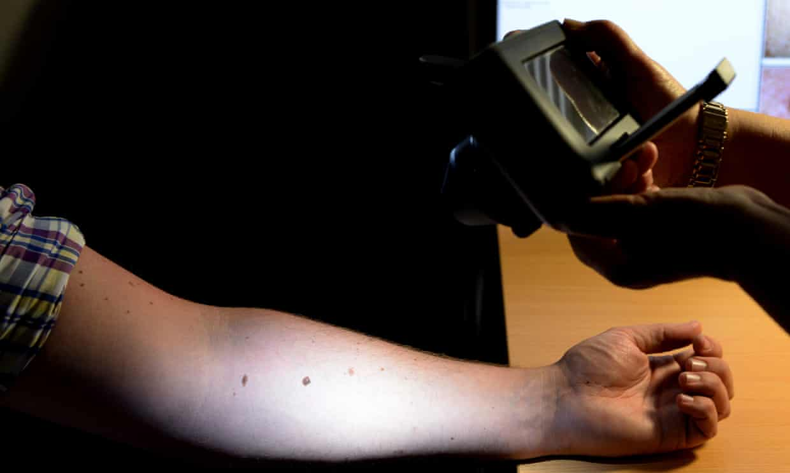
RESEARCH AND DEVELOPMENT
Computer learns to detect skin cancer more accurately than doctors: Artificial intelligence machine found 95% of melanomas in study compared to 86.6% for dermatologists.

Slide 43
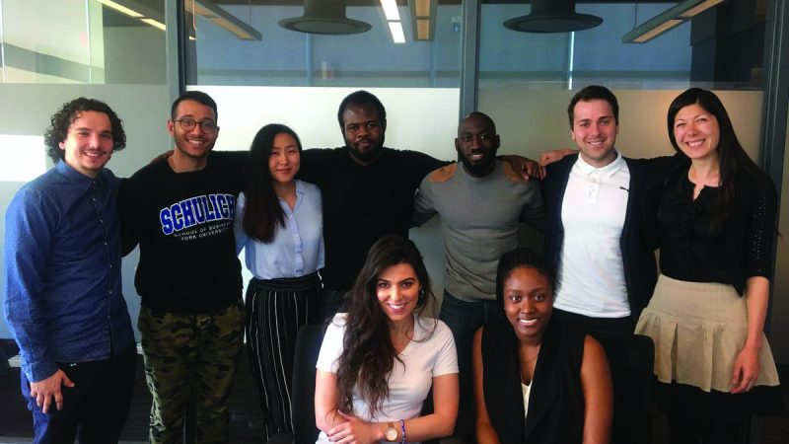
Artificial Intelligence (AI) changing the job market.
The future of job recruitment starts today.
Founded by Schulich undergraduates Ali El-Shayeb and Mariam Walaa, the LaunchYU startup project “Nugget” uses artificial intelligence (AI) to streamline job recruitment, targeted towards employers who would assess candidates during the interviewing process.

Slide 44

FINALLY DONE WITH THE THEORY PART LETS HAVE SOME FUN NOW…

Slide 45
Movies on machine learning
Money Ball
Ex Machina
Blade Runner
Her
Artificial Intelligence
Margin Call
The Imitation Game
21
The Matrix
A Beautiful mind

Slide 46

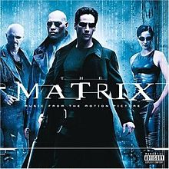


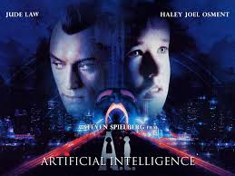

Slide 47


Slide 48


Slide 49


Slide 50



Slide 51
REFERENCES
https://en.wikipedia.org/wiki/Sophia_(robot)
https://www.analyticsvidhya.com/blog/2015/11/10-watch-movies-data-science-machine-learning/
https://www.google.co.in/search?q=fraud+detection&rlz=1C1GGRV_enIN791IN791&source=lnms&tbm=isch&sa=X&ved=0ahUKEwj4z6X65-LdAhVMpI8KHcvFDpMQ_AUIDigB&biw=1536&bih=674#imgrc=a0ARtoN76hUSmM:
https://www.coursera.org/learn/machine-learning/supplement/d5Pt1/lecture-slides
https://www.coursera.org/learn/machine-learning/supplement/1O0Bk/unsupervised-learning
https://www.theguardian.com/society/2018/may/29/skin-cancer-computer-learns-to-detect-skin-cancer-more-accurately-than-a-doctor
https://excal.on.ca/artificial-intelligence-ai-changing-the-job-market/

Slide 52

THANK YOU.

